Slide 1
FinSolve - VaultRAG Assistant
The VaultRAG Assistant streamlines secure information retrieval across departments.
Shashank Nallabothu

Slide 2
2
Why we Build This ?
Introduction
VaultRAG Architecture
Tech Stack at Glance
Build in Security
Intelligent Routing
Live Demo
Future Enhancements
Final Words
OVERVIEW

Slide 3

3
Why We Build This ?
Imagine a curious engineer poking around finance numbers, or a new hire trying to decode your company policies buried in files. We built this to fix that.
Think of it like:
A digital librarian who whispers only the right answers.
A RAG-powered search engine aware of job roles.
A security guard that says: 'You shall not pass!'

Slide 4
4
INTRODUCTION
The FinSolve VaultRAG Assistant streamlines document management of FinSolve, ensuring secure access and efficient retrieval of information across departments, boosting organizational intelligence.

Slide 5
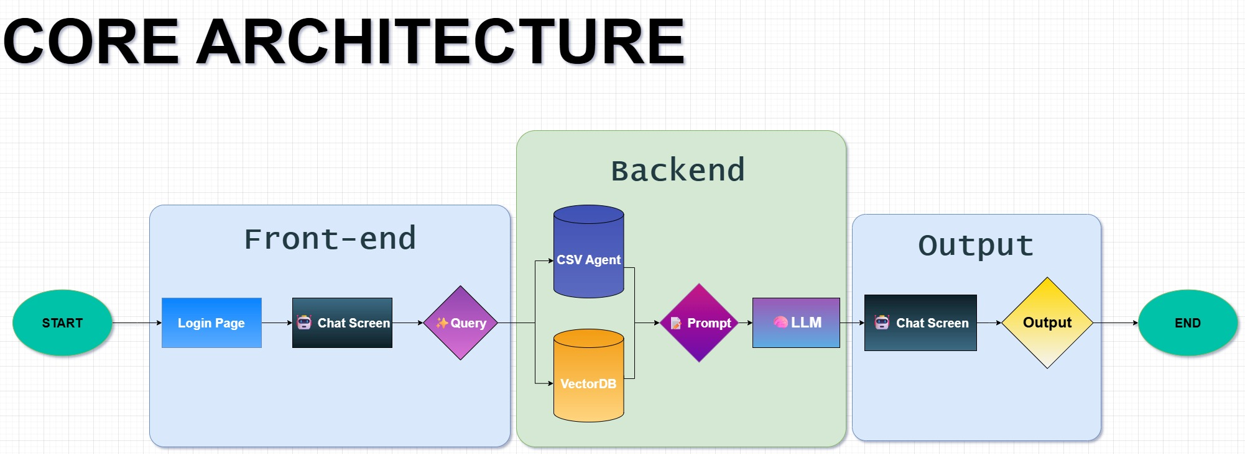
5
VaultRAG Architecture
VaultRAG utilizes Retrieval-Augmented Generation (RAG) with role-aware filters, ensuring enhanced data retrieval and generation capabilities.

Slide 6
6
Backend: FastAPI + RAG
Frontend: Streamlit
LLM: HuggingFace + Ollama
Vector DB: ChromaDB
Auth: Role-based (RBAC)
Storage: Markdown & CSV (hierarchically chunked)
Tech Stack at Glance

Slide 7

7
Build-In
Security
Sensitive information is protected effectively.
Chunking and tagging enhance document organization.
Accessibility is improved through structured handling.

Slide 8
8
Role-Based Access Control
RBAC ensures secure access based on user roles.
Sensitive information is protected effectively.
Chunking and tagging enhance document organization.
Accessibility is improved through structured handling.

Slide 9
9
Metadata Tagging on all chunks
Hierarchical Context Retention - Every chunk carries its parent section’s header as metadata
Traceable Answers – Users can see exactly where the answer came from – complete transparency

Slide 10
10
Auth on every endpoint
Frontend + Backend Synced – Even UI elements dynamically respond to authenticated role access.
Role-Aware Validation – Auth tokens aren’t just passcodes they carry your role for downstream filtering.

Slide 11
11
Intelligent Routing between different docs
Query-Type Detection – Distinguishes between CSV-based (structured) vs Markdown-based (unstructured) questions.
Specialized Agents – Routes CSV queries to a tabular data agent, while RAG handles textual knowledge.

Slide 12
12
Live Demo Question
C-Level: Who is getting the Highest Salary,
What is out current Tech Stack
Engineer: What is out current Tech Stack
Who is getting the Highest Salary
HR: Leave Policies?
Who is getting the Highest Salary
Employee: Maternity leave?

Slide 13
13
Future Enhancements
Single Sign-On
VaultRAG is set to integrate Single Sign-On (SSO) for streamlined access, improving user experience and security.
Human in Loop
If both sources are relevant, the system prompts for user decision.

Slide 14
14
Conclusion
01
VaultRAG revolutionizes knowledge management by integrating security with efficiency, fostering collaboration among teams.
02
This innovative approach enhances organizational intelligence, ensuring that valuable insights are accessible and secure.
03
By empowering teams, VaultRAG transforms how organizations manage and utilize their internal knowledge.

Slide 15
Thank You!
We appreciate it!
Shashank Nallabothu

